Slide 1
CSS for Page Layout, Responsive CSS,
Accessible Colours
PROG8540
Web Foundations

Slide 2
Topics
Altering Position of Elements and Creating Layers
Different CSS Backgrounds
Accessible Colours
Overflowing Elements
Introduction to Responsive CSS

Slide 3
Position Property and Layers ^{[1]}
Position property like floats is used to alter the normal flow of the elements on the web page.
Different positionings available in CSS are:
  Static positioning
  Relative positioning
  Fixed positioning
  Absolute positioning
  Other complex positioning
    Combining CSS Positions
    Sticky Positioning.
position: static;
position: relative;
position: fixed;
position: absolute;
z-index: 999;
position: sticky;

Slide 4
CSS Properties of Backgrounds^{[2]}
Background colours
Background images
Background gradients
body{
background-color: thistle;
}
.stars{
background-image: url('stars.png');
}
.myGradient{
background-image: linear-gradient(90deg, rgba(238,174,202,1) 0%, rgba(148,187,233,1) 100%);
}

Slide 5
Accessible Colours
For your website: choose colours that have good contrast between the foreground and background colours.
Adding backgrounds to elements with text: sometimes renders the text unreadable for the visitors.
A dark-coloured text should be avoided on dark background.
A light-coloured text should be avoided on a light background.
The latest standards as per the AODA for web accessibility are WCAG 2.0 AA.
Use colour contrast checker tools like this one from WebAIM for checking if the colours of your website confirm the WCAG 2.0 AA standards.

Slide 6

Accessible Colours
Video: Testing Color Contrast & Simulating Color Blindness with the Firefox Accessibility Inspector (8:52)

Slide 7
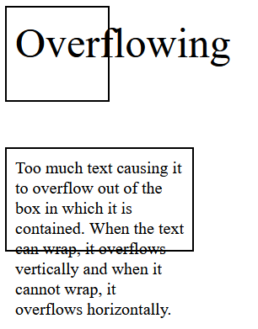
CSS Overflow ^{[3]}
Here is a sample CSS that hides the overflowing content from a box with a class hideIt:
.hideIt{
overflow: hidden;
}
Figure 1. Image showing overflowing content horizontally and vertically out of two boxes.

Slide 8
Responsive CSS ^{[4]}
Responsive CSS: Adapt websites to any device size
Set the Viewport
Use CSS Media
Queries to write
new CSS rules
for different
screen sizes.
<!DOCTYPE html>
<html lang="en">
<head>
…
<meta name="viewport" content="width=devicewidth, initial-scale=1">
…
</head>
…
@media (max-width: 600px) {
/*This is where you can write CSS for screens smaller than or equal to 600px*/
}
@media (min-width: 601px) {
/* This is where you can write CSS for screen greater than or equal to 601px */
}

Slide 9

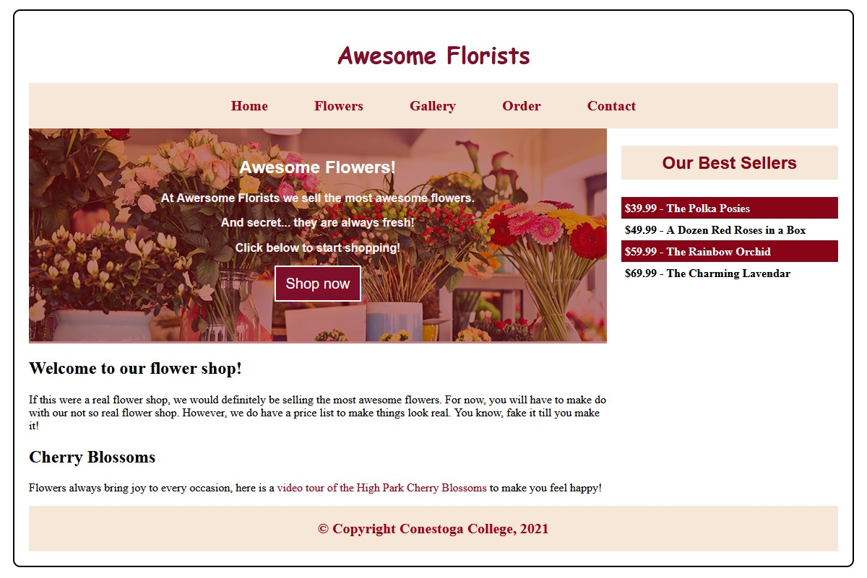
Practice:
Desktop view
Mobile view

Slide 10
References
1. Adapted from Mozilla Contributors. (2020). Positioning. Retrieved January 11, 2021.
https://developer.mozilla.org/en-US/docs/Learn/CSS/CSS_layout/Positioning
Licensed under CC BY-SA 2.5
2. Adapted from Mozilla Contributors. (2020). Backgrounds and borders. Retrieved January 11, 2021.
https://developer.mozilla.org/en-US/docs/Learn/CSS/Building_blocks/Backgrounds_and_borders
Licensed under CC BY-SA 2.5
3. Adapted from Mozilla Contributors. (2021). Overflowing content. Retrieved January 11, 2021.
https://developer.mozilla.org/en-US/docs/Learn/CSS/Building_blocks/Overflowing_content
Licensed under CC BY-SA 2.5
4. Adapted from LePage, P., & Andrew, R. (2020, May 14). Responsive web design basics. Retrieved January 27, 2021.
https://web.dev/responsive-web-design-basics/
Content Licensed under Creative Commons Attribution 4.0 License.
Code Licensed under Apache 2.0 License

Slide 11
References
Mozilla Developer. (2019, November 13). Testing Color Contrast & Simulating Color Blindness with the Firefox Accessibility Inspector [Video]. YouTube. https://www.youtube.com/watch?v=eBefjaWud-M
Copyright Notice
The content on this document that is adapted from Mozilla Contributors is available under the terms of the Creative Commons Attribution-ShareAlike license (CC-BY-SA), v2.5 or any later version.

Slide 12
Thank you!
Any questions?

