Slide 1
CSS Selectors, Cascading, The Box Model and Floats
PROG8540
Web Foundations

Slide 2
Topics
CSS Selectors
Types of Selectors
Cascading
Box Model
Display Property
Normal Flow
Float Property

Slide 3
CSS Selectors^{[1]}
Selectors in CSS are used to target HTML elements on a web page for styling.
Types of Selectors
  Type, Class and ID
  Attribute selectors
  Pseudo-classes and Pseudo-elements
  Combinators

Slide 4
Type, Class and ID ^{[2]}
Type: Selector that targets an HTML element using the tag names
The HTML code:
Corresponding CSS:
<h1>Test heading in green. </h1>
h1{
color: green;
}

Slide 5
Type, Class and ID ^{[2]}
Class: used to assign one or more classes to a tag which can be used as CSS selectors
The HTML code:
Corresponding CSS:
<h1 class="blueHeading">Test heading in blue. </h1>
.blueHeading{
color: blue;
}

Slide 6
Type, Class and ID ^{[2]}
ID: works much like the ‘Class’ selector with three key differences
  One that the id is specified in the ‘id’ attribute of the tag,
  Second that the CSS rule uses hash (#) along with the id as a selector
  Third that only one id can be given to an element.
The HTML code:
Corresponding CSS:
<h1 id="specialHeading">Test heading will be underlined. </h1>
#specialHeading{
text-decoration: underline;
}

Slide 7
Attribute selectors ^{[3]}
Attributes other than ‘class’ and ‘id’ that can also be used to target a specific element.
Commonly used on anchor tags and tags used for forms and elements for creating different components of a form.
The HTML code:
Corresponding CSS:
<a href="https://www.conestogac.on.ca/" title="Conestoga College">This will show up in red.</a>
<a href="https://www.conestogac.on.ca/">This will show up in default blue.</a>
a[title]{
color: red;
}

Slide 8
Pseudo-classes and Pseudo-elements ^{[4]}
Used to target an element in a particular state.
A pseudo-class is used to define a special state of an element.
The HTML Code:
Corresponding CSS:
<a href="https://www.conestogac.on.ca/">This will be displayed depending on element state</a>
a:link{
color: red;
}
a:visited{
color: blue;
}
a:hover{
color: yellow;
}
a:active{
color: orange;
}

Slide 9
Pseudo-classes and Pseudo-elements ^{[4]}
Used to target an element in a particular state.
A CSS pseudo-element is used to style specified parts of an element.
The HTML Code:
Corresponding CSS:
<p>The first letter of this paragraph is displayed in red</p>
p::first-letter{
color: red;
}

Slide 10
Combinators ^{[5]}
Used to combine more than one selector to create a specific selector with useful relationships between the HTML elements.
Types of Combinators
  Descendant combinator (space)
  Child combinator (>)
  Adjacent sibling combinator (+)
  General sibling combinator (~)

Slide 11
Combinators: Descendant combinator ^{[5]}
Represented by a single space and reflects an ancestor-child relationship.
CSS code:
The HTML code:
main p{
color: red;
}
<body>
<main>
<p>This paragraph will show up in red colour. </p>
<p>This paragraph will also show in red colour. </p>
<section>
<h2>Some heading</h2>
<p>This paragraph will also show up in red colour.</p>
</section>
</main>
<p>This paragraph will show in the default colour. </p>
</body>

Slide 12
Combinators: Child combinator ^{[5]}
Uses the greater than sign ( > ) and represents a parent-child relationship.
CSS code:
The HTML code:
main > p{
color: red;
}
<body>
<main>
<p>This paragraph will show up in red colour. </p>
<p>This paragraph will also show in red colour. </p>
<section>
<h2>Some heading</h2>
<p> This paragraph will show up in the default colour. </p>
</section>
</main>
<p>This paragraph will show up in the default colour. </p>
</body>

Slide 13
Combinators: Adjacent sibling combinator ^{[5]}
Uses the plus ( + ) character to select the element right next to another element such that both the elements have the same parent.
CSS code:
The HTML code:
h2 + p{
font-weight: bold;
}
<body>
<main>
<h1>This is the main page heading.</h1>
<p>This paragraph will show up in regular font.</p>
<p>This paragraph will show up in regular font.</p>
<h2>This is sub page heading.</h2>
<p>This paragraph will show up in bold font.</p>
<p>This paragraph will show up in regular font.</p>
<section>
<h2>Some heading</h2>
<p>This paragraph will show up in bold font.</p>
<p>This paragraph will show up in regular font.</p>
</section>
</main>
</body>

Slide 14
Combinators: General sibling combinator ^{[5]}
Uses the tilde ( ~ ) character to select all the next siblings of an element.
CSS code:
The HTML code:
h2 ~ p{
font-weight: bold;
}
<body>
<main>
<h1>This is the main page heading.</h1>
<p>This paragraph will show up in regular font.</p>
<p>This paragraph will show up in regular font.</p>
<h2>This is sub page heading.</h2>
<p>This paragraph will show up in bold font.</p>
<p>This paragraph will show up in bold font.</p>
<h3>This is a sub sub heading.</h3>
<p>This paragraph will show up in bold font.</p>
<section>
<p>This paragraph will show up in regular font.</p>
<p>This paragraph will show up in regular font.</p>
</section>
</main>
</body>

Slide 15
Multiple Elements and Selectors ^{[1]}
To apply the same CSS to more than one element, you can combine the previously learned selectors in a list to apply the CSS rule to multiple elements.
To create a list of the selectors, you use the comma ( , ) character.
The following separate CSS rules:
h1{
color: indigo;
}
h2{
color: indigo;
}
a[title]{
color: indigo;
}
.specialList{
color: indigo;
}
Can be combined into one CSS rule as follows:
h1, h2, a[title], .specialList {
color: indigo;
}

Slide 16
Cascading ^{[6]}
To understand how CSS will behave in case of conflicting rules.
Conflicting CSS are resolved using the cascading in CSS.
The HTML code:
Corresponding CSS:
<p class="specialParagraph">
The colour of the text will be decided using cascading.
</p>
p{
color:gray;
}
.specialParagraph{
color: maroon;
}

Slide 17
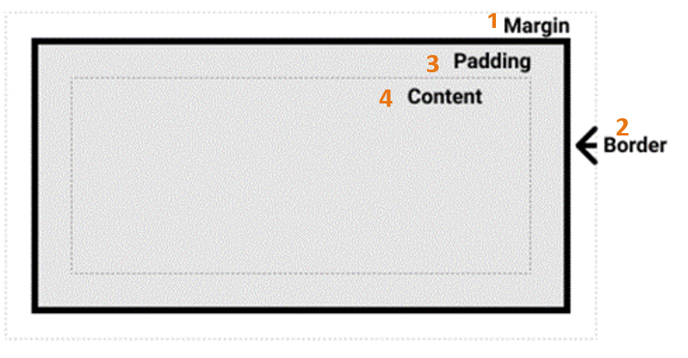
Box Model- Review ^{[7]}
HTML web pages are built up of boxes.
One box is created for each HTML element by the browser when it renders the HTML.
The CSS box model elements:
  Margin box
  Border box
  Padding box
  Content box
Figure 1. The CSS box model.
Note. From Mozilla Contributors, 2019. CC BY-SA 2.5

Slide 18
Calculating The Total Space ^{[7]}
The following formulas can be used to calculate the actual width and height of the content box:
Total width = left border + left padding + width + right padding + right border
Total height = top border + top padding + height + bottom padding + bottom border
As a thumb rule to find out the space needed by a box on the web page, you can use the following formula:
Width needed for the box to fit = left margin + left border + left padding + width + right padding + right border + right margin

Slide 19
Display Property ^{[7]}
Used to control how the elements occupy space on a page.
Also controls the layout of the elements.
Based on outer display type, CSS boxes are of these types:
  block
  inline
Other display property values:
  none
  inline-block
  table
  flex
  grid

Slide 20
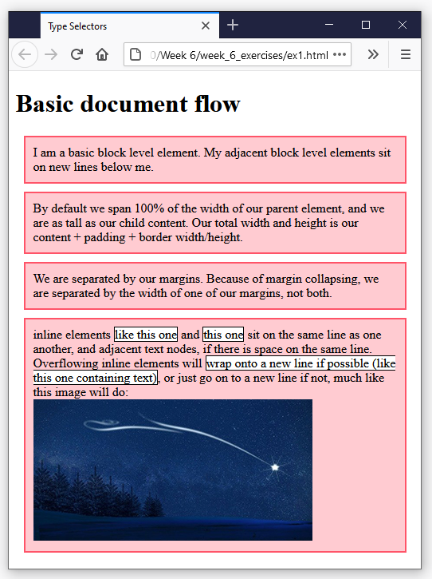
Normal Flow^{[8]}
Default layout that is applied to the elements if no CSS has been used to change their display or position property.
Figure 2. The normal flow in CSS.

Slide 21
Float Property
Used to create different kinds of layouts by changing the flow of an element.
General syntax to float something left:
float: left;

Slide 22
Summary
Types of CSS selectors
Combine selectors to target specific HTML elements
Cascading in CSS
CSS box model
Normal flow of elements in a web page layout
Altering the normal flow of an element using float

Slide 23
References
1. Adapted from Mozilla Contributors. (2021). CSS selectors. Retrieved 2021, January 09.
https://developer.mozilla.org/en-US/docs/Learn/CSS/Building_blocks/Selectors
Licensed under CC BY-SA 2.5
2. Adapted from Mozilla Contributors. (2021). Type, class, and ID selectors. Retrieved 2021, January 09.
https://developer.mozilla.org/en-US/docs/Learn/CSS/Building_blocks/Selectors/Type_Class_and_ID_Selectors
Licensed under CC BY-SA 2.5
3. Adapted from Mozilla Contributors. (2021). Attribute selectors. Retrieved 2021, January 09.
https://developer.mozilla.org/en-US/docs/Learn/CSS/Building_blocks/Selectors/Attribute_selectors
Licensed under CC BY-SA 2.5
4. Adapted from Mozilla Contributors. (2021). Pseudo-classes and pseudo-elements. Retrieved 2021, January 10.
https://developer.mozilla.org/en-US/docs/Learn/CSS/Building_blocks/Selectors/Pseudo-classes_and_pseudo-elements
Licensed under CC BY-SA 2.5
5. Adapted from Mozilla Contributors. (2021). Combinators. Retrieved 2021, January 10.
https://developer.mozilla.org/en-US/docs/Learn/CSS/Building_blocks/Selectors/Combinators
Licensed under CC BY-SA 2.5

Slide 24
References
6. Adapted from Mozilla Contributors. (2021). Cascading and Inheritance. Retrieved 2021, January 10.
https://developer.mozilla.org/en-US/docs/Learn/CSS/Building_blocks/Cascade_and_inheritance
Licensed under CC BY-SA 2.5
7. Adapted from Mozilla Contributors. (2021). The box model. Retrieved 2021, January 10.
https://developer.mozilla.org/en-US/docs/Learn/CSS/Building_blocks/The_box_model
Licensed under CC BY-SA 2.5
8. Adapted from Mozilla Contributors. (2020). Normal Flow. Retrieved 2021, January 11.
https://developer.mozilla.org/en-US/docs/Learn/CSS/CSS_layout/Normal_Flow
Licensed under CC BY-SA 2.5
9. Adapted from Mozilla Contributors. (2020). Floats. Retrieved 2021, January 11.
https://developer.mozilla.org/en-US/docs/Learn/CSS/CSS_layout/Floats
Licensed under CC BY-SA 2.5
Copyright Notice
The content on this document that is adapted from Mozilla Contributors is available under the terms of the Creative Commons Attribution-ShareAlike license (CC-BY-SA), v2.5 or any later version.

Slide 25
Thank you!
Any questions?

